Slide 1
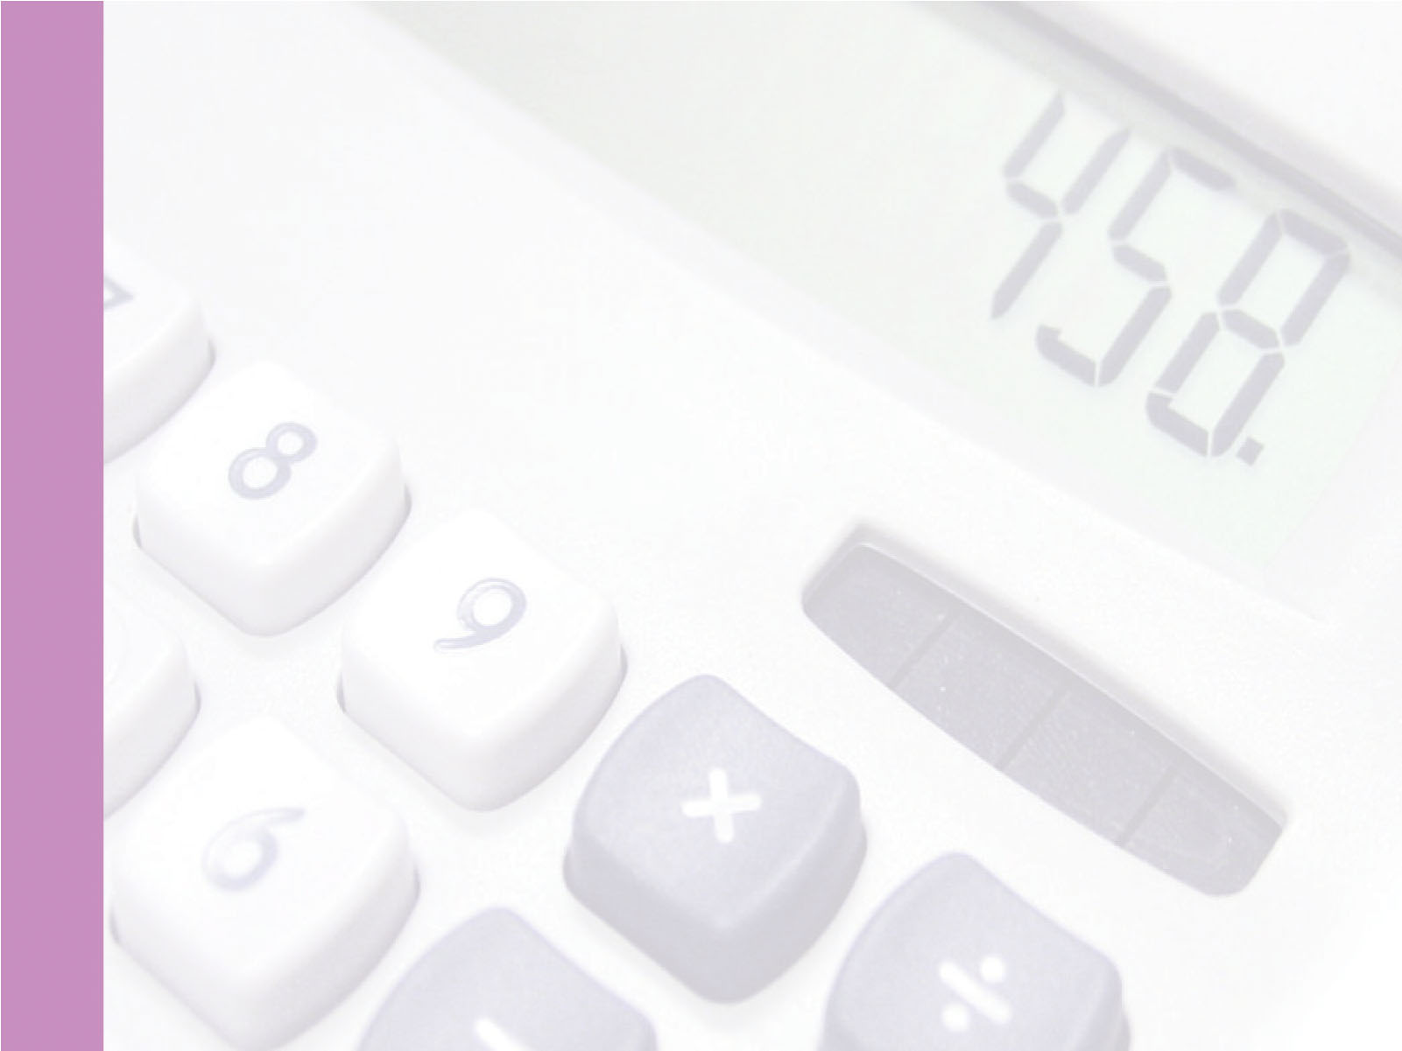
Next Hikes IT Solution
BUILDING BASIC CALCULATOR
Iftisum Rahaman

Slide 2

Project Objective
To develop a simple calculator using Python which provides :
Simple arithmetic operation.
The operation performed are:
Addition.
Subtraction.
Multiplication.
Division.
Clearing the content of the screen.

Slide 3
About The Project
GUI Calculator is a calculator that can be used by clicking buttons. In this calculator, all its numbers and operators are represented graphically and can be used with one click.
GUI is a visual and more easy way to interact with the computer. It includes graphical representation like buttons and icons and we can interact with these icons rather than text based interaction.
Tkinter is an library which provides GUI app to work with and manage all errors in the background. It's easy to use, lightweight and cross-platform. It's simple and practical to create a calculator using Tkinter's many functions.

Slide 4
The Knowledge I Gain
Study briefly about the Python Programming.
And also learnt how to design and implement the coding skills.
Now I could explore more and more. Adding advanced features like scientific calculations, history tracking, or even integrating the calculator into a larger application.

Slide 5
Setting Up The Calculator
Window creation
We will start by creating the main window using the Tkinter "Tk()" function and setting its properties.
Widgets and layout
We will then add various widgets like buttons, labels, and input fields to create the calculator interface.
Grid Placement
To arrange the widgets, we will use the grid layout system provided by Tkinter.
Number Input
We will create functions to handle the input of numeric values and update the display accordingly.
Operator Input
Functions will be implemented to capture user's selection of mathematical operators.
Clear and equal
The "Clear" and "Equal" buttons will be programmed to reset the calculator or execute the calculator.

Slide 6
Conclusion
By completing this Tkinter Python Calculator project I have gained valuable experience in GUI develpoment, event handling and creating functional desktop applications. Thus the advanced GUI calculator showcases the fusion of technical expertise and user-centric design, serving as a testament to the capabilities of Python in modern software development.

Slide 7
THANK YOU

